Slide 1
I2C DRIVER

Slide 2
I2C introduction
I2C (inter-integrated circuit) bus Interface serves as an interface between the microcontroller and the serial I2C bus. It provides multimaster capability, and controls all I2C bus-specific sequencing, protocol, arbitration and timing. It supports the standard mode (Sm, up to 100 kHz) and Fm mode (Fm, up to 400 kHz).
2C main features
Multimaster capability: the same interface can act as Master or Slave
I2C Master features:
– Clock generation
– Start and Stop generation
I2C Slave features:
– Programmable I2C Address detection
– Dual Addressing Capability to acknowledge 2 slave addresses
– Stop bit detection
Analog noise filter
Status flags:
– Transmitter/Receiver mode flag
– End-of-Byte transmission flag
– I2C busy flag

Slide 3
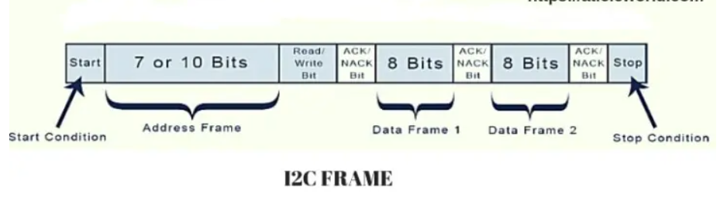
Read 1: đọc từ slave
Write 0: write tới slave
Ack =0: sucess
Ack=1: fail
Start Condition: The SDA line switches from a high voltage level to a low voltage level before the SCL line switches from high to low.
Stop Condition: The SDA line switches from a low voltage level to a high voltage level after the SCL line switches from low to high.
Address Frame: A 7 or 10 bit sequence unique to each slave that identifies the slave when the master wants to talk to it.
Read/Write Bit: A single bit specifying whether the master is sending data to the slave (low voltage level) or requesting data from it (high voltage level).
ACK/NACK Bit: Each frame in a message is followed by an acknowledge/no-acknowledge bit. If an address frame or data frame was successfully received, an ACK bit is returned to the sender from the receiving device.

Slide 4
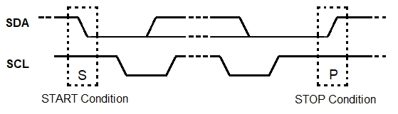
Start Condition: The SDA line switches from a high voltage level to a low voltage level before the SCL line switches from high to low.
Stop Condition: The SDA line switches from a low voltage level to a high voltage level after the SCL line switches from low to high.
Address Frame: A 7 or 10 bit sequence unique to each slave that identifies the slave when the master wants to talk to it.
Read/Write Bit: A single bit specifying whether the master is sending data to the slave (low voltage level) or requesting data from it (high voltage level).
ACK/NACK Bit: Each frame in a message is followed by an acknowledge/no-acknowledge bit. If an address frame or data frame was successfully received, an ACK bit is returned to the sender from the receiving device.

Slide 5
ADDRESSING
I2C doesn’t have slave select lines like SPI, so it needs another way to let the slave know that data is being sent to it, and not another slave. It does this by addressing. The address frame is always the first frame after the start bit in a new message.
The master sends the address of the slave it wants to communicate with to every slave connected to it. Each slave then compares the address sent from the master to its own address. If the address matches, it sends a low voltage ACK bit back to the master. If the address doesn’t match, the slave does nothing and the SDA line remains high.
READ/WRITE BIT
The address frame includes a single bit at the end that informs the slave whether the master wants to write data to it or receive data from it.
If the master wants to send data to the slave, the read/write bit is a low voltage level. If the master is requesting data from the slave, the bit is a high voltage level.

Slide 6
THE DATA FRAME
After the master detects the ACK bit from the slave, the first data frame is ready to be sent.
The data frame is always 8 bits long, and sent with the most significant bit first.
Each data frame is immediately followed by an ACK/NACK bit to verify that the frame has been received successfully.
The ACK bit must be received by either the master or the slave (depending on who is sending the data) before the next data frame can be sent.
After all of the data frames have been sent, the master can send a stop condition to the slave to halt the transmission. The stop condition is a voltage transition from low to high on the SDA line after a low to high transition on the SCL line, with the SCL line remaining high.

Slide 7
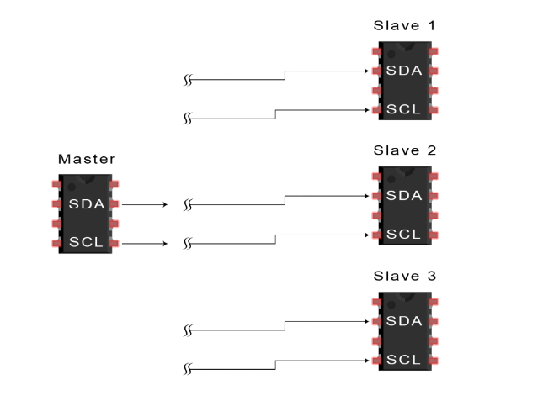
STEPS OF I2C DATA TRANSMISSION
1
The master sends the start condition to every connected slave by switching the SDA line from a high voltage level to a low voltage level before switching the SCL line from high to low:

Slide 8
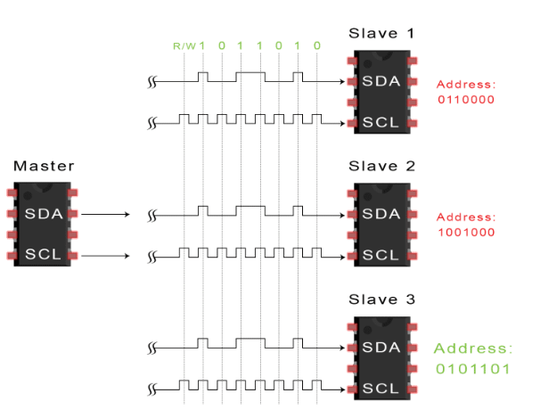
2
The master sends each slave the 7 or 10 bit address of the slave it wants to communicate with, along with the read/write bit:

Slide 9
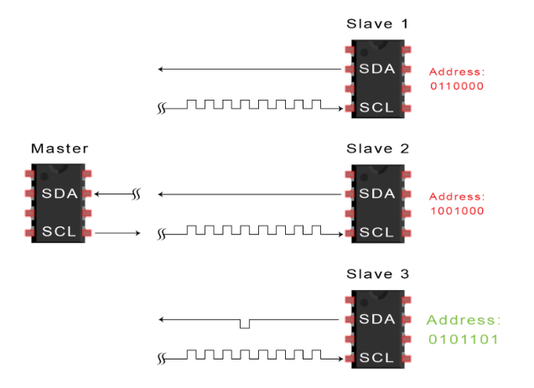
3
Each slave compares the address sent from the master to its own address. If the address matches, the slave returns an ACK bit by pulling the SDA line low for one bit. If the address from the master does not match the slave’s own address, the slave leaves the SDA line high.

Slide 10
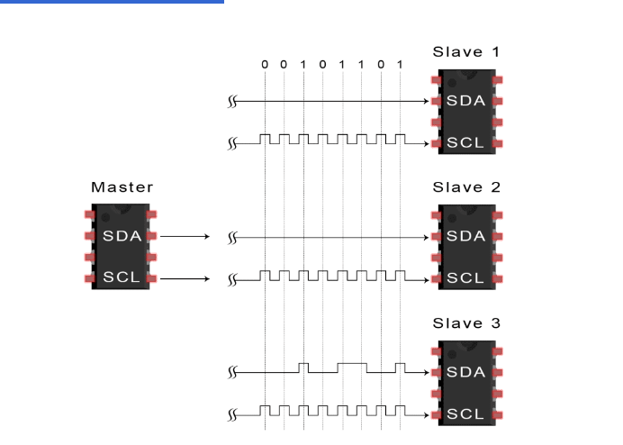
4
The master sends or receives the data frame:

Slide 11
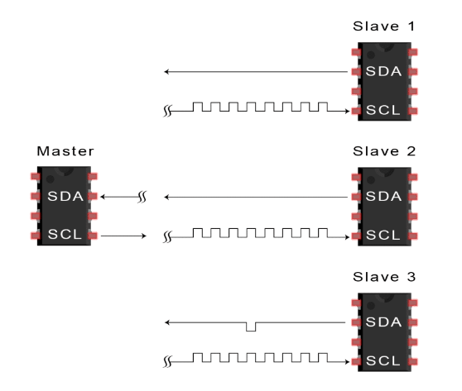
5
After each data frame has been transferred, the receiving device returns another ACK bit to the sender to acknowledge successful receipt of the frame:

Slide 12
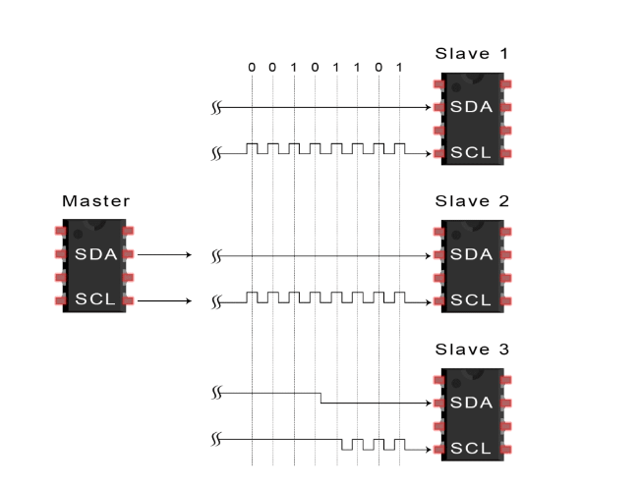
6
To stop the data transmission, the master sends a stop condition to the slave by switching SCL high before switching SDA high:

Slide 13
Mode selection
The interface can operate in one of the four following modes:
• Slave transmitter
• Slave receiver
• Master transmitter
• Master receiver
By default, it operates in slave mode. The interface automatically switches from slave to master, after it generates a START condition and from master to slave, if an arbitration loss or a Stop generation occurs, allowing multimaster capability.

Slide 14
Communication flow
In Master mode, the I2C interface initiates a data transfer and generates the clock signal. A serial data transfer always begins with a start condition and ends with a stop condition. Both start and stop conditions are generated in master mode by software.
In Slave mode, the interface is capable of recognizing its own addresses (7 or 10-bit), and the General Call address. The General Call address detection may be enabled or disabled by software.
Data and addresses are transferred as 8-bit bytes, MSB first. The first byte(s) following the start condition contain the address (one in 7-bit mode, two in 10-bit mode). The address is always transmitted in Master mode.

Slide 15
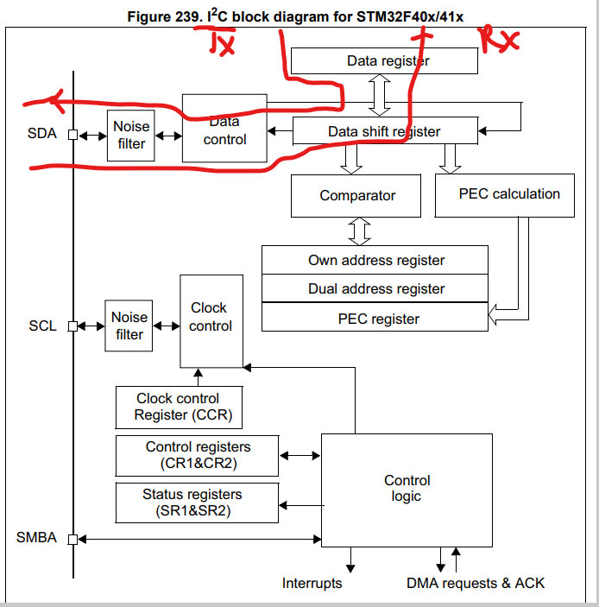

Slide 16
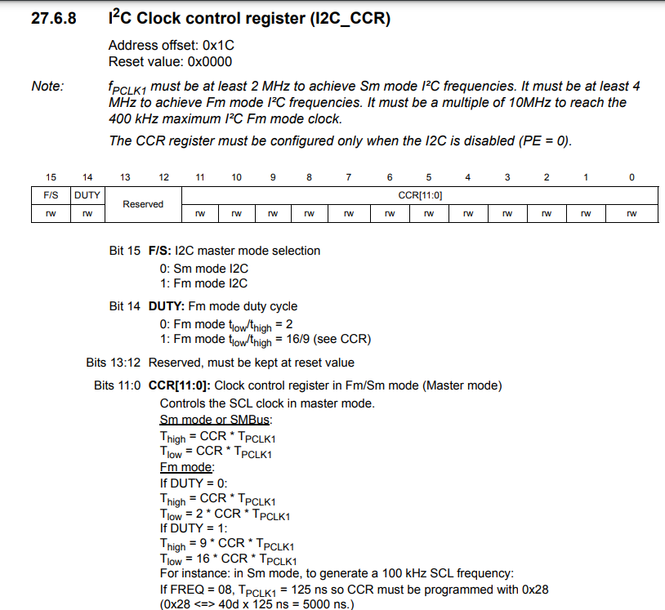

Slide 17
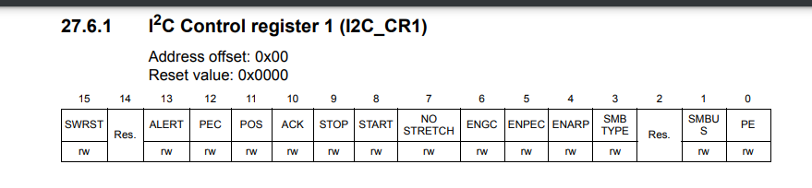
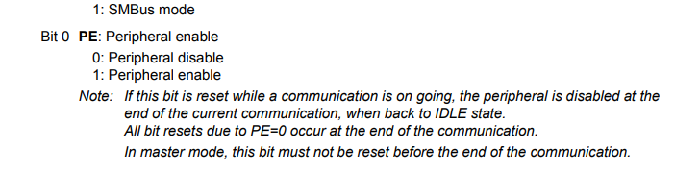
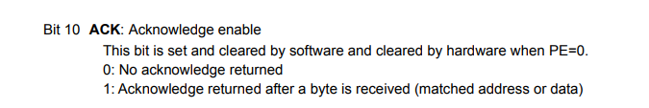

Slide 18
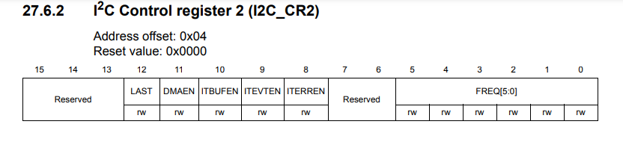
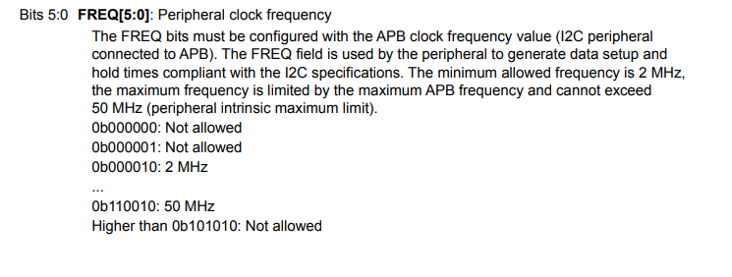

Slide 19
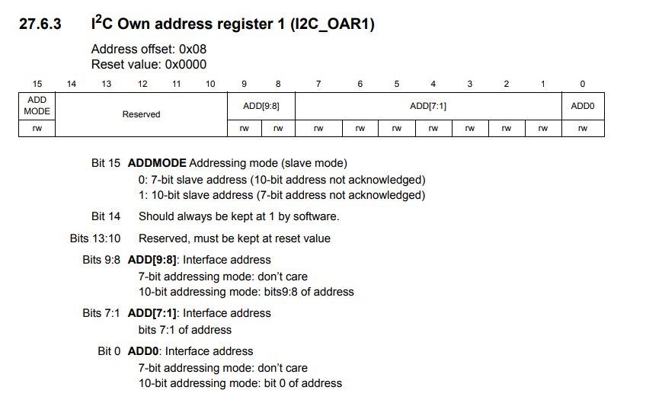

Slide 20
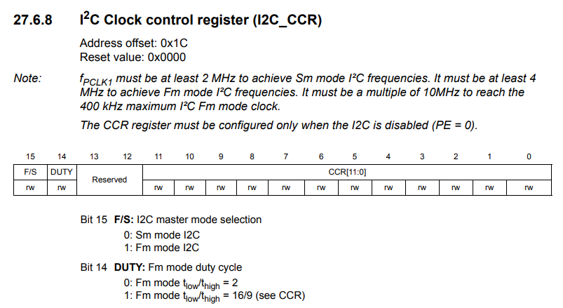

Slide 21
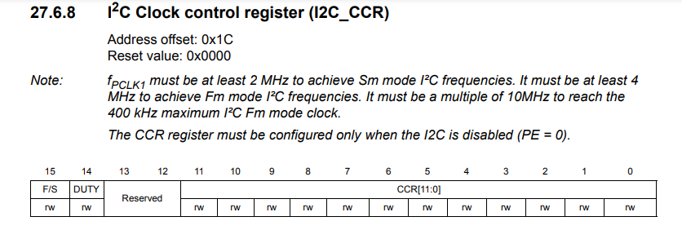
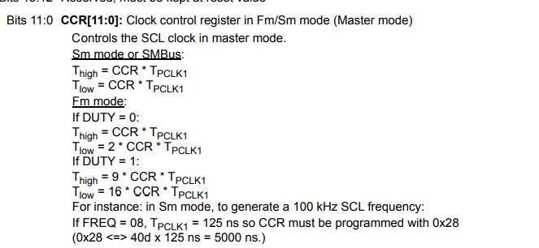

Slide 22
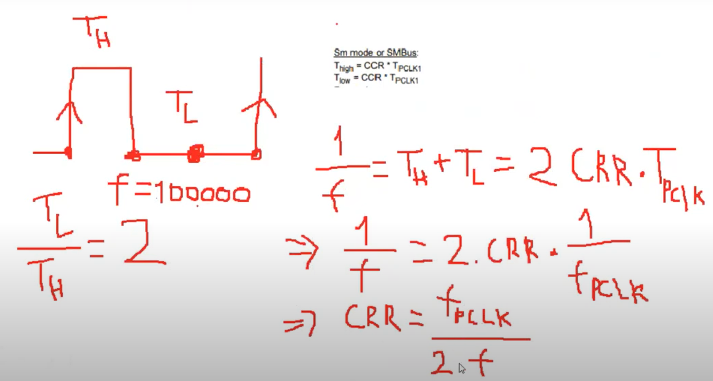

Slide 23
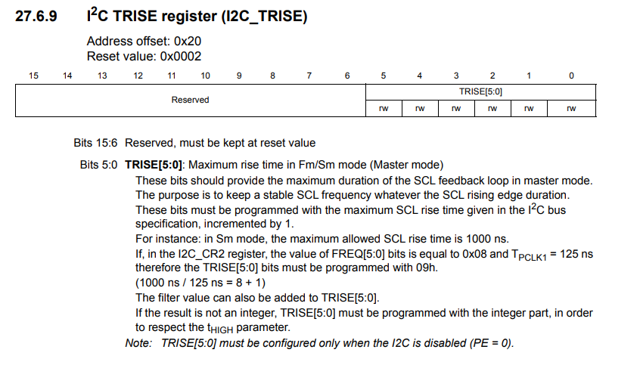

Slide 24
I2C master mode
In Master mode, the I2C interface initiates a data transfer and generates the clock signal. A serial data transfer always begins with a Start condition and ends with a Stop condition. Master mode is selected as soon as the Start condition is generated on the bus with a START bit.
The following is the required sequence in master mode.
• Program the peripheral input clock in I2C_CR2 register in order to generate correct timings
Configure the clock control registers
Configure the rise time register
Program the I2C_CR1 register to enable the peripheral
Set the START bit in the I2C_CR1 register to generate a Start condition
The peripheral input clock frequency must be at least:
2 MHz in Sm mode
• 4 MHz in Fm mode

Slide 25
SCL master clock generation
The CCR bits are used to generate the high and low level of the SCL clock, starting from the generation of the rising and falling edge (respectively). As a slave may stretch the SCL line, the peripheral checks the SCL input from the bus at the end of the time programmed in TRISE bits after rising edge generation.
Các bit CCR (Clock Control Register) được sử dụng trong ngữ cảnh giao tiếp I2C (Inter-Integrated Circuit) để điều khiển tạo ra tín hiệu SCL (Serial Clock). Tín hiệu SCL được sử dụng để đồng bộ quá trình truyền dữ liệu giữa các thiết bị.
Khi các thiết bị truyền dữ liệu qua bus I2C, các bit CCR được sử dụng để tạo ra mức cao và mức thấp của tín hiệu SCL, bắt đầu từ việc tạo ra cạnh dương và cạnh âm tương ứng.
Do một thiết bị slave có thể kéo dài (stretch) đường truyền SCL, thiết bị ngoại vi kiểm tra tín hiệu SCL được đưa vào từ bus vào cuối thời gian được lập trình trong các bit TRISE sau khi tạo ra cạnh dương.
Nếu đường truyền SCL thấp, điều này có nghĩa là một thiết bị slave đang kéo dài bus, và bộ đếm mức cao dừng lại cho đến khi đường truyền SCL được phát hiện là cao. Điều này đảm bảo thời gian mức cao tối thiểu của tín hiệu SCL.
Nếu đường truyền SCL cao, bộ đếm mức cao tiếp tục đếm.

Slide 26
Start condition
Setting the START bit causes the interface to generate a Start condition and to switch to Master mode (MSL bit set) when the BUSY bit is cleared.
Note: In master mode, setting the START bit causes the interface to generate a ReStart condition at the end of the current byte transfer.
Once the Start condition is sent:
• The SB bit is set by hardware and an interrupt is generated if the ITEVFEN bit is set

Slide 27
Slave address transmission
Then the slave address is sent to the SDA line via the internal shift register
In 7-bit addressing mode, one address byte is sent.
As soon as the address byte is sent
– The ADDR bit is set by hardware and an interrupt is generated if the ITEVFEN bit is set.
The master can decide to enter Transmitter or Receiver mode depending on the LSB of the slave address sent.
• In 7-bit addressing mode
– To enter Transmitter mode, a master sends the slave address with LSB reset.
– To enter Receiver mode, a master sends the slave address with LSB set

Slide 28
Master transmitter
Following the address transmission and after clearing ADDR, the master sends bytes from the DR register to the SDA line via the internal shift register.
The master waits until the first data byte is written into I2C_DR (see Figure 243 Transfer sequencing EV8_1).
When the acknowledge pulse is received, the TxE bit is set by hardware and an interrupt is generated if the ITEVFEN and ITBUFEN bits are set.
If TxE is set and a data byte was not written in the DR register before the end of the last data transmission, BTF is set and the interface waits until BTF is cleared by a write to I2C_DR, stretching SCL low.
Closing the communication
After the last byte is written to the DR register, the STOP bit is set by software to generate a Stop condition (see Figure 243 Transfer sequencing EV8_2). The interface automatically goes back to slave mode (MSL bit cleared).

Slide 29
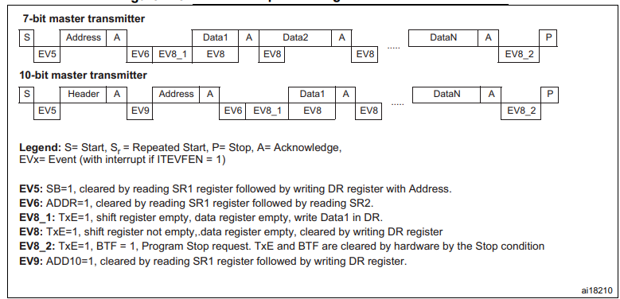
Transfer sequence diagram for master transmitter
Làm sao biết được byte cuối cùng ?

Slide 30
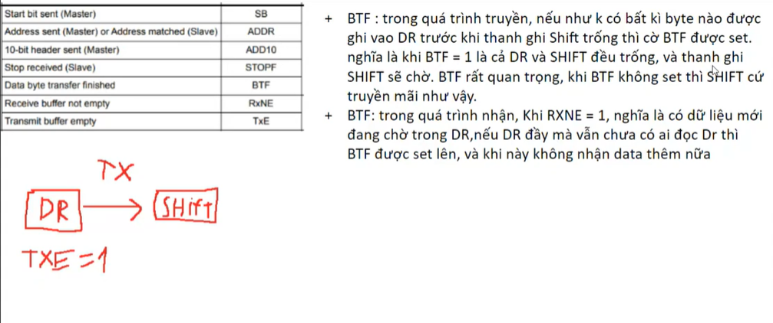

Slide 31
Master receiver
Following the address transmission and after clearing ADDR, the I2C interface enters Master Receiver mode. In this mode the interface receives bytes from the SDA line into the DR register via the internal shift register. After each byte the interface generates in sequence:
1. An acknowledge pulse if the ACK bit is set
2. The RxNE bit is set and an interrupt is generated if the ITEVFEN and ITBUFEN bits are set (see Figure 244 Transfer sequencing EV7)
If the RxNE bit is set and the data in the DR register is not read before the end of the last data reception, the BTF bit is set by hardware and the interface waits until BTF is cleared by a read in the DR register, stretching SCL low.
Closing the communication
The master sends a NACK for the last byte received from the slave. After receiving this NACK, the slave releases the control of the SCL and SDA lines. Then the master can send a Stop/Restart condition.
To generate the nonacknowledge pulse after the last received data byte, the ACK bit must be cleared just after reading the second last data byte (after second last RxNE event).
2. In order to generate the Stop/Restart condition, software must set the STOP/START bit after reading the second last data byte (after the second last RxNE event).
3. In case a single byte has to be received, the Acknowledge disable is made during EV6 (before ADDR flag is cleared) and the STOP condition generation is made after EV6

Slide 32
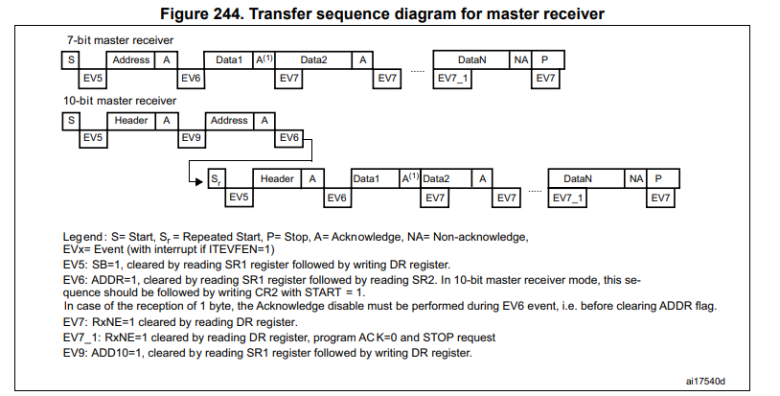
Nhận 1 byte và nhận nhiều byte ?

Slide 33
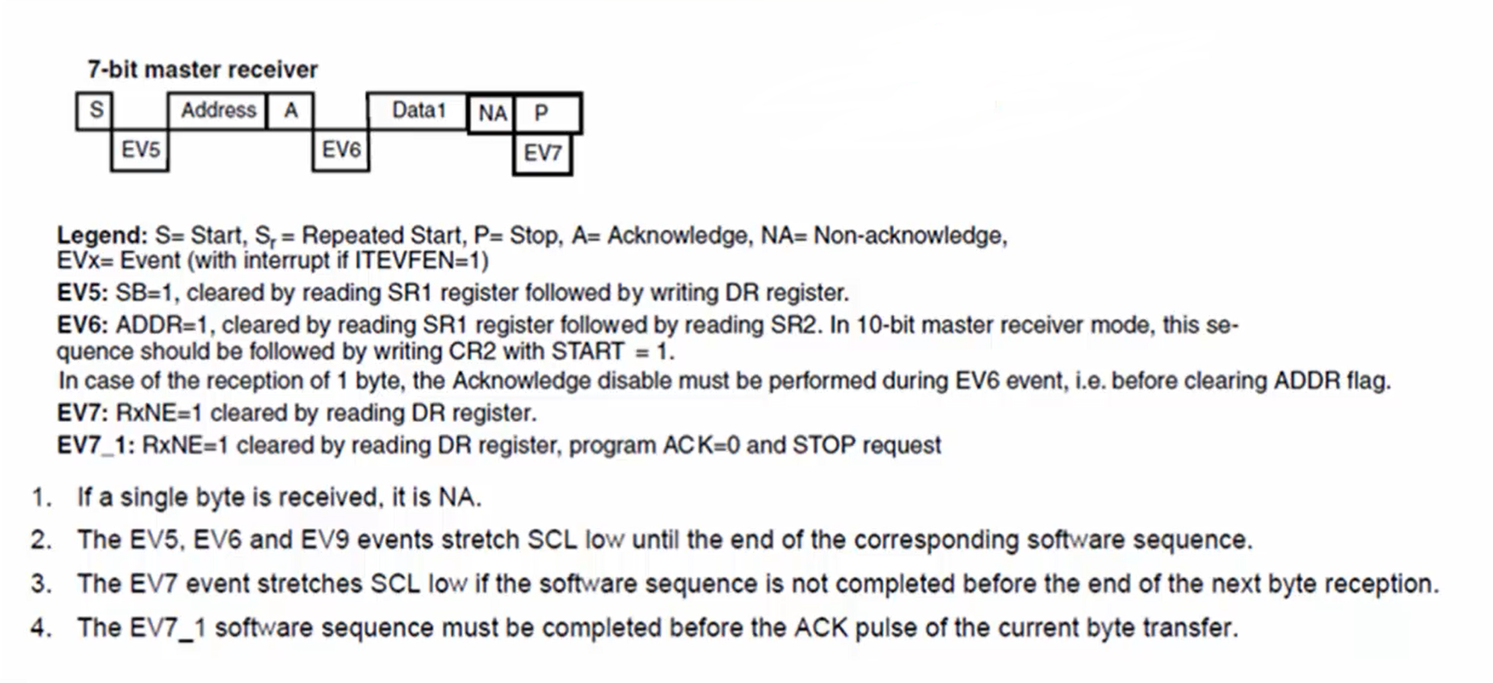
Single byte
Master generates the start condition.
Master code clears the start bit flag.
Master sends the address of the slave.
The slave will send the ACK after receiving the address.
ADDR flag is set. When the ADDR flag is set, the clock is stretched, and both master and slave are paused.
Before clearing the ADDR flag, disable the ACKing and then program the stop bit of the control register.
Clear the ADDR flag. When you make ADDR as zero, the clock will be released, and data reception begins. Since you have already programmed ACK is equal to zero, NACK will be sent to the slave, and it stops sending more data.
Confirm RXNE =1 and read the data from the data register.

Slide 34
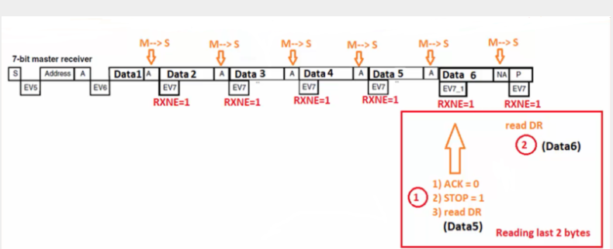
Mutile bytes
Master receiving more than one byte from the slave. Consider that the master wants to receive 6 bytes, so the length is equal to 6 bytes.
Master generates the start condition.
Master sends the address of the slave.
The slave will send the ACK after receiving the address.
ADDR flag is equal to 1.
Once you clear the ADDR flag, the master receives the first byte and sends the ACK to the slave.
The master code waits until RXNE is equal to one. When RXNE=1, the master code reads first data, i.e., Data1, and parallelly Data2 will be received from the master, and the ACK for that will be sent. Then the master reads the second byte from the data register.
Similarly, Data3 and Data4 will be received and read from the data register.

Slide 35
In the software, you have to count the length. Before reading the data, initially, the length will be 6, and it is decremented by one after each byte transfer.
After reading the Data4 from the data register, the length becomes 2. When length = 2, program the ACK=0 and STOP=1. This is a procedure to receive the last two bytes.
Read Data5. After reading Data5, the length will become 1, meaning that only one byte is pending.
Since the ACK is programmed to zero when the length is equal to 2. For the last data byte or Data6, NACK will be sent instead of ACK.
Since the stop bit is programmed to 1, the stop condition will be generated by the master.
Read the last byte from the data register.
When the master is receiving more than 1 byte, then if length = 2, make ACK = 0, STOP =1, and read the data. When you make ACK = 0, STOP =1, it sends NACK to the last data byte which is received. This is a thumb rule, and it states that sending the ACK for the last data byte received is wrong.
https://fastbitlab.com/stm32-i2c-lecture-29-i2c-transfer-sequence-diagram-master-receiving-data/

Slide 36
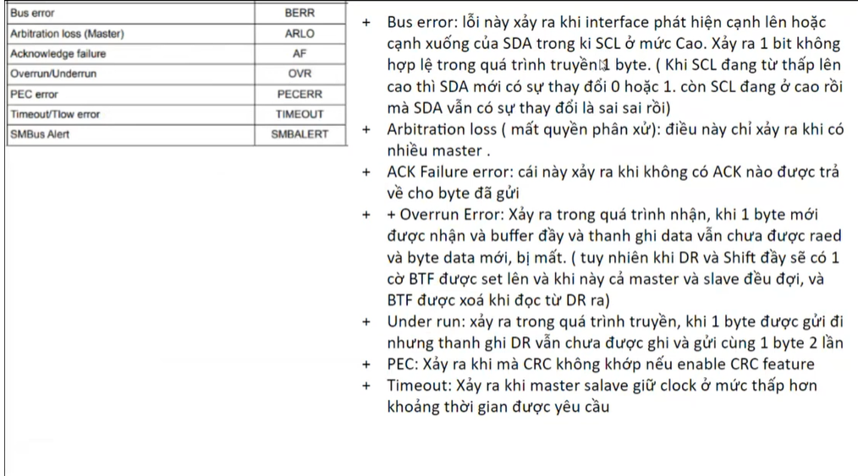

Slide 37
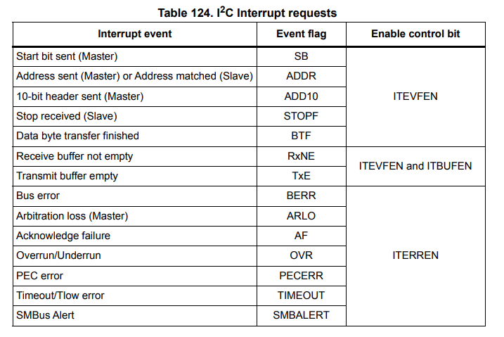
I2C interrupts

Slide 38
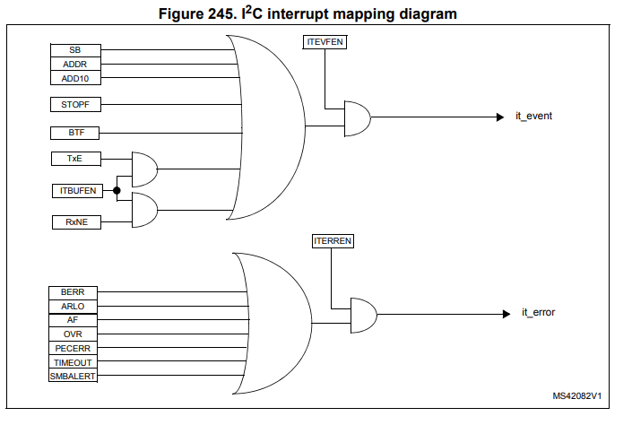

Slide 39
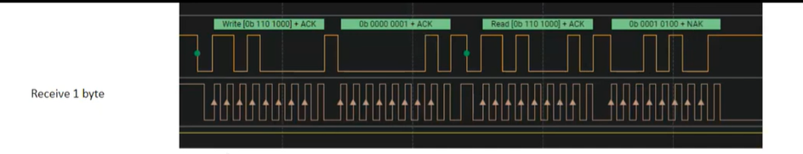
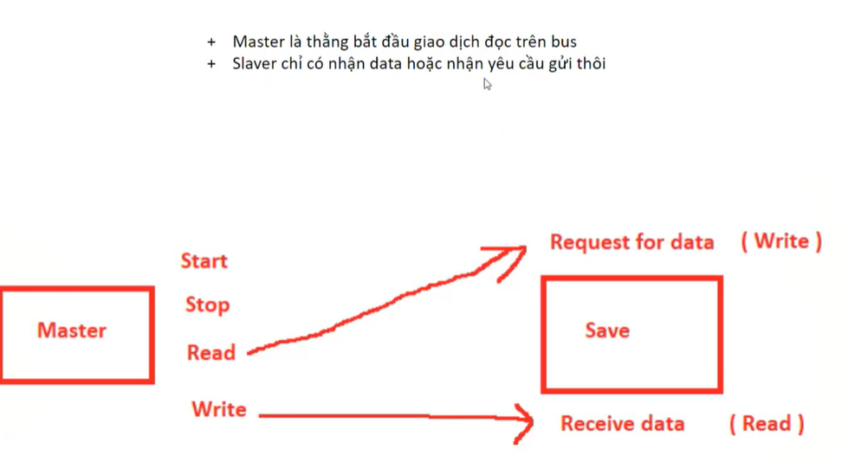

Slide 40
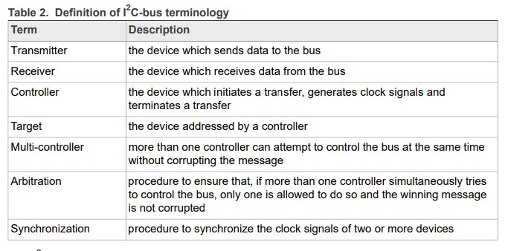
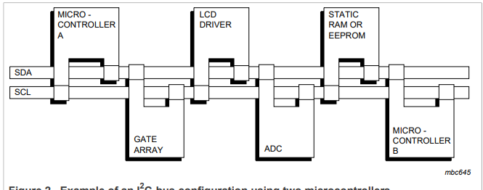

Slide 41
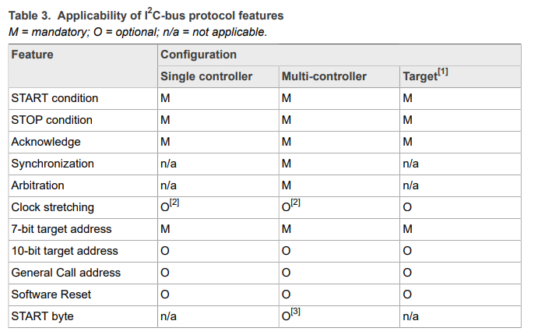
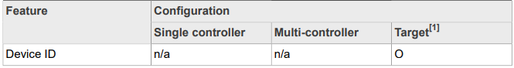
summarizes the use of mandatory and optional portions of the I2C-bus specification and which system configurations use them.

Slide 42
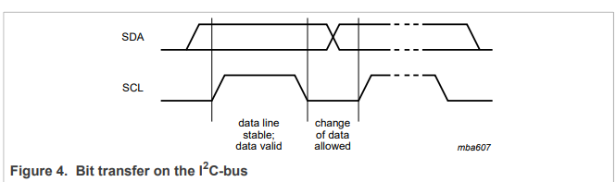
SDA and SCL signals
Both SDA and SCL are bidirectional lines, connected to a positive supply voltage via a current-source or pull-up resistor
When the bus is free, both lines are HIGH.
Data on the I2C-bus can be transferred at rates of up to 100 kbit/s in the Standard-mode, up to 400 kbit/s in the Fast-mode, up to 1 Mbit/s in Fast-mode Plus, or up to 3.4 Mbit/s in the High-speed mode. The bus capacitance limits the number of interfaces connected to the bus.
The data on the SDA line must be stable during the HIGH period of the clock. The HIGH or LOW state of the data line can only change when the clock signal on the SCL line is LOW (see Figure 4). One clock pulse is generated for each data bit transferred.

